Slide 1
FLASH ID Overview

Slide 2
Day 1 Agenda
FLASH ID Introduction
FLASH ID Framework Overview
FLASH ID Application

Slide 3
FLASH ID: Introduction
FLASH ID: Forensic Language Independent Analysis System for Handwriting Identification
Language independent - tested on many different languages
In its current configuration, it is designed handle over 20,000 enrolled handwriting samples
The system can be laptop, desktop or server based

Slide 4
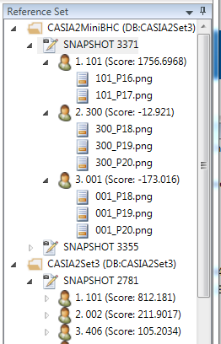
Reference Database Definitions
Reference Database – Database of sets of known writing
Reference Set – Set of known writing
Reference Set Snapshot – Version of a Reference Set
Writer – Individual Writer within a Reference Set
Document – Individual Document for a Writer
Score – Matching Score for a Writer against a Test Document

Slide 5
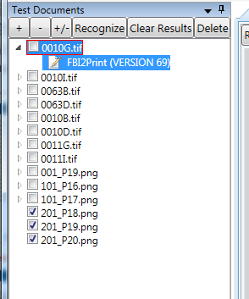
Test Documents Definitions
Test Document – Document of questioned writing
Recognition Result Set – Set of comparison results for a Test Document against a Reference Set Snapshot
Test Document Database – Database of Test Documents and their Recognition Result Sets

Slide 6
FLASH ID Framework Overview

Slide 7



FLASH ID: Framework
FLASH ID has a well-defined framework for comparing handwriting; it combines
a method for segmenting writing into graphs;
A method for automatic isomorphic classification for graphs;
a method for assigning a meaningful shape definition for graphs.
This framework allows that writings be compared in a “like to like” manner.
Isomorphism Class 4;112.0
Shape Code

Slide 8



FLASH ID: Image Processing
Image Processing: FLASH ID takes a scanned image (300 dpi) of a document, segments it, and skeletonizes each segment, yielding a one pixel wide skeleton. The skeleton is converted into graphs. The writing can be regarded as a combination of graphs with nodes and edges.
Original Word:
Original Word with skeleton exposed:
Extracted Skeleton (graph):

Slide 9


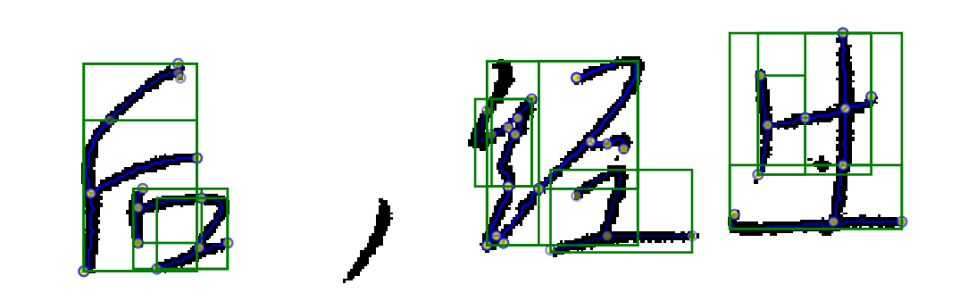
FLASH ID: Language Independence
Handwritten English and Handwritten Arabic are segmented into graphemes by a common algorithm. Chinese (and related scripts use a different algorithm).
English Script:
Arabic:
Chinese:

Slide 10

FLASH ID: Encoding Handwriting as Data
The connectivity pattern of the nodes and edges defines the isomorphism class of graphs.
Neither bending the edges, changing the length of the edges, reorienting the image, nor reflecting the image changes the isomorphism class.
The shape class of a graph is determined by the geometric relationships between parts of the graph.
Each graph has a Feature Vector of physical measurements.
Handwritten text
Isomorphism Class 4;112.0
Shape Class

Slide 11


FLASH ID: Encoding Handwriting
Graphemes:
Isomorphic Classes:
Class Feature Vector:

Slide 12
FLASH ID: Writer Modeling
Modeling based on Writers’ known writings:
The combination of an isomorphism class and a shape class defines a Grapheme Type.
Writing is modeled at the Grapheme Type level.
Physical measurements of the Graphemes of each Grapheme Type are analyzed using discriminate analysis to identify differences and similarities between Reference Writers.
Stored data (in a Reference Set) from these discriminant analyses are used to identify the Writers of Test Documents.
(More detail in FLASH ID In Depth presentation)

Slide 13
FLASH ID: Reference Writer Scoring
The Test Document is preprocessed, yielding Analysis Graphemes.
Each Writer in the database of interest whose known writings contain instances of the Grapheme Type of the Analysis Grapheme receives a Reward Score for the Analysis Grapheme.
Writers’ Reward Scores are accumulated for all Analysis Graphemes in the Questioned Writing.
Writers in the database of interest are ranked according to their cumulative Reward Scores for the Questioned Writing.

Slide 14
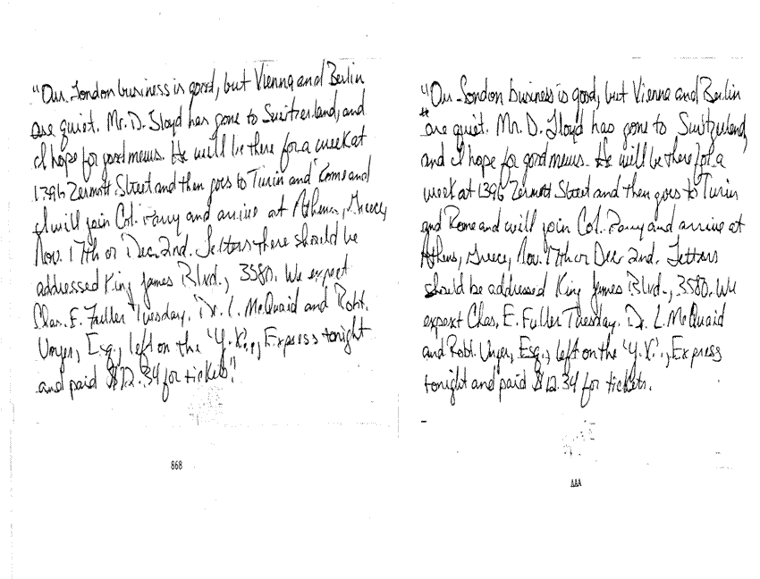
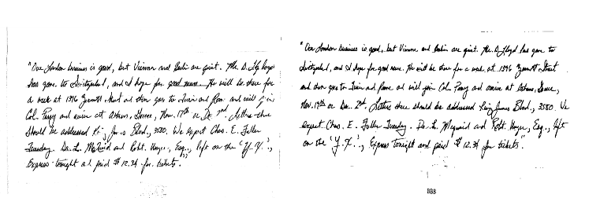
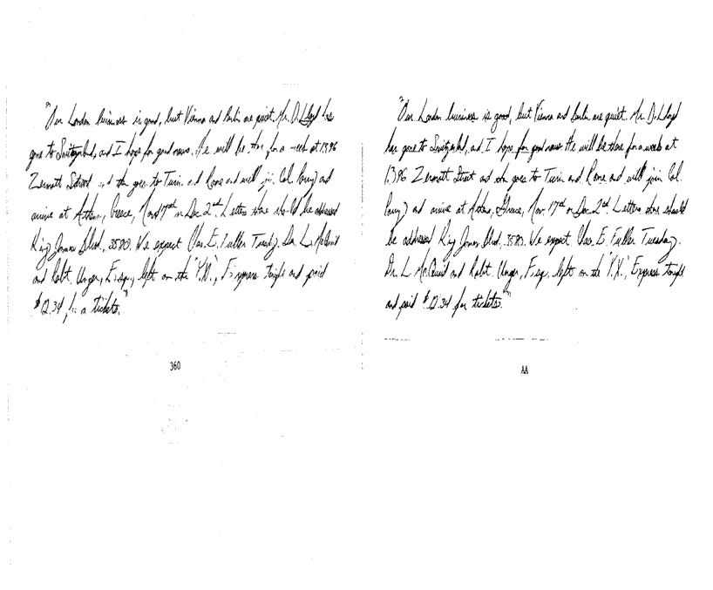
FLASH ID: Sample Test Results
Reference match 868 and unknown image AAA
Closed Set Blind Test: 56 London paragraphs had a match among a data base of 1,000 London paragraphs. 55 were top ranked by FLASH ID.
Reference match 892 and unknown image BBB
Rank | Results
 | Number | Percent | Cumulative
1 | 55 | 98.2 | 98.2
2 | 0 | 0 | 98.2
3 | 0 | 0 | 98.2
4 | 0 | 0 | 98.2
5 | 0 | 0 | 98.2
6-10 | 1 | 1.8 | 100.0
Reference match 360 and unknown image AA

Slide 15
FLASH ID Application

Slide 16
FLASH ID: User Instructions
Loading and processing questioned documents
Reviewing processing results
Exporting Data
Updating reference databases

Slide 17
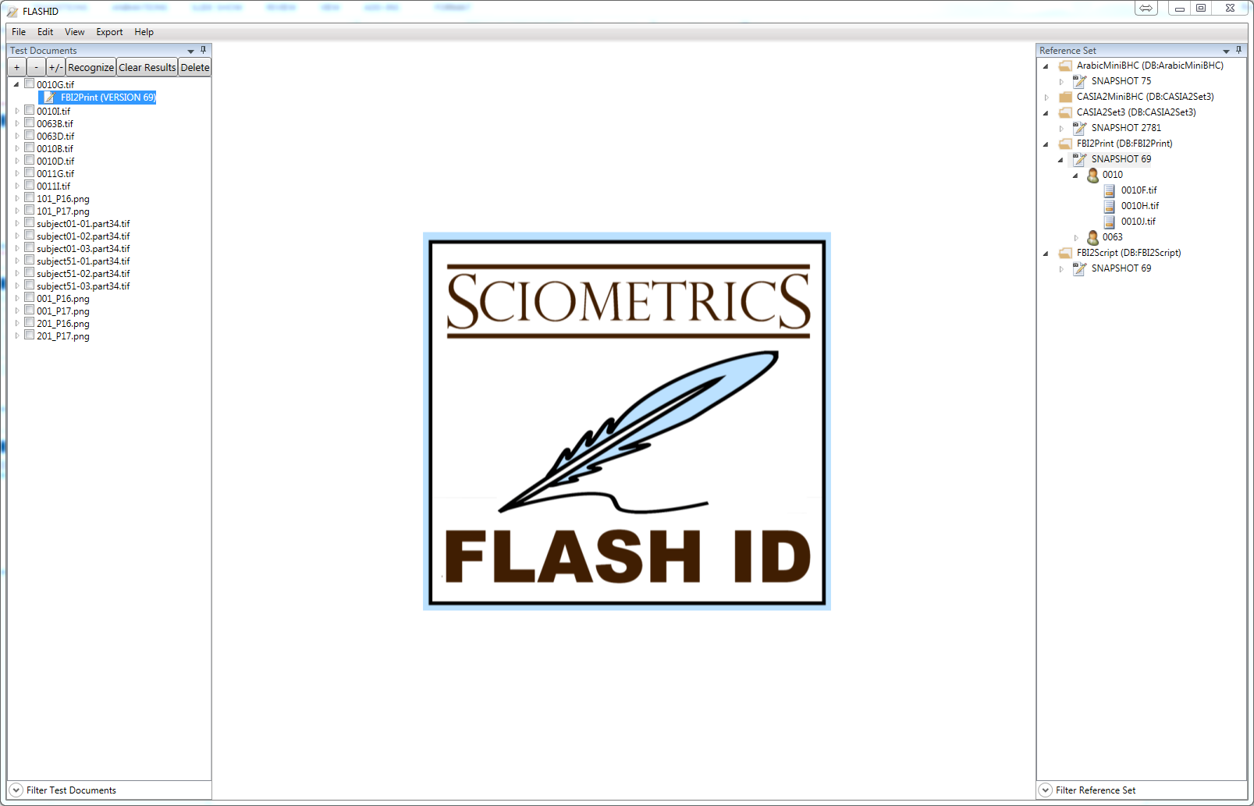
Review of Terms
Main Menu
Action
Buttons
Reference
Set
Test Document
Reference Database
Recognition
Result Set
Reference Set
Snapshot
Check Box
Writer
Reference Document

Slide 18
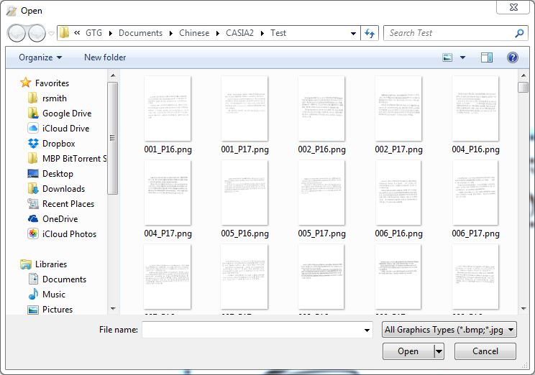
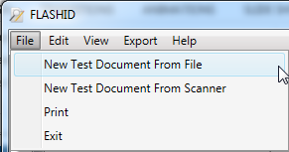
Loading a Test Document
Test Documents are loaded using the File:New Test Document From File Menu Item Or File:New Test Document From Scanner Menu Item
Existing files may be loaded one at a time or in batches
Standard bitmap image file formats are supported

Slide 19
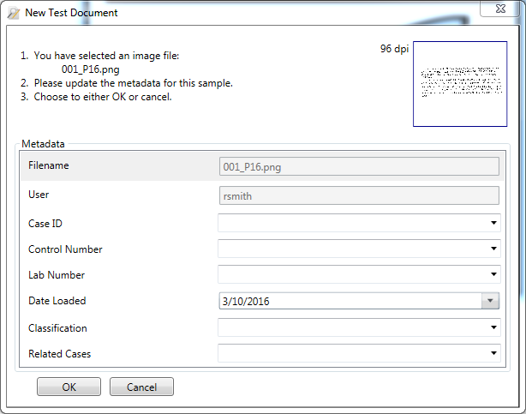
Loading a Test Document (cont’d)
When loading documents one at a time, metadata may be added as the document is loaded
Metadata for documents loaded in batches can be added later
Metadata fields can be customized
User, filename, and date loaded are automatically stored
Test Document can be opened by double clicking the Test Document Name in the list of Test Documents
Only one document at a time can be opened

Slide 20

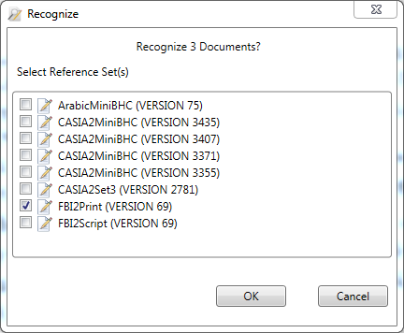
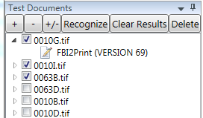
Processing Test Documents
Test documents are processed using the Recognize Button above the open document Or Recognize Button above the Test Documents List
The Recognize button above the Test Documents List operates on all Test Documents that have their Checkbox selected
OR

Slide 21
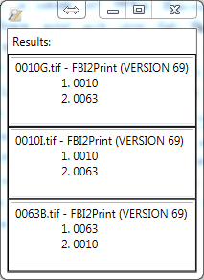
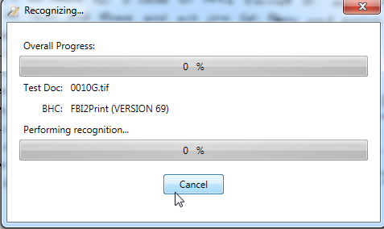
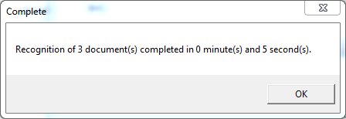
Processing Test Documents (cont’d)
Multiple Test Documents may be processed at the same time
The Test Documents may be compared against one or more Reference Set Snapshots

Slide 22
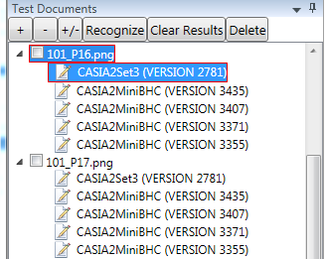
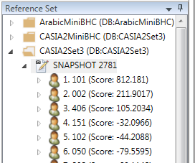
Processing Test Documents (cont’d)
Each Test Document can save one Recognition Result Set for each Reference Set Snapshot
When a Recognition Results Set is selected, the corresponding Reference Set Snapshot is sorted accordingly and shows the scores from that result set
Re-processing a test document against a Reference Set Snapshot will replace the Recognition Result Set

Slide 23
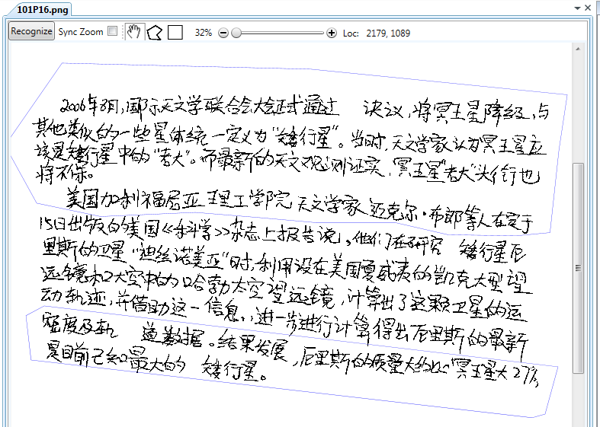
Processing Test Documents (cont’d)
Test Documents can be annotated with one or more Regions of Interest using tools in the toolbar above an open Test Document
The Region of Interest restricts the section of the document that will be used for recognition processing
This can be used to focus processing on a particular area of a Test Document or to exclude areas of a Test Document
Region of Interest areas can be drawn as rectangles or polygons
Regions of Interest are shown as blue outlined shapes and are saved with the Recognition Result Set

Slide 24
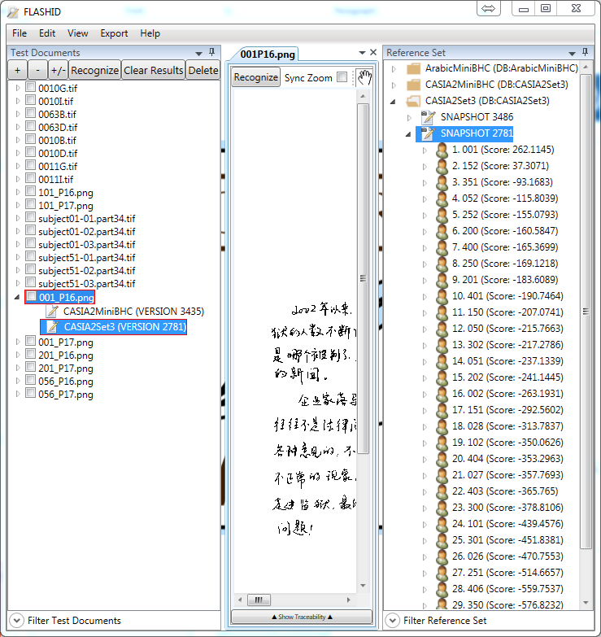
Reviewing Recognition Results
Recognition results are displayed by double clicking on a Recognition Result Set
The Test Document is automatically opened and the corresponding Reference Set Snapshot is shown and sorted by the Recognition Results Scores in descending order
Recognition Results Scores provide a measure of similarity between the Test Document and each Reference Writer

Slide 25
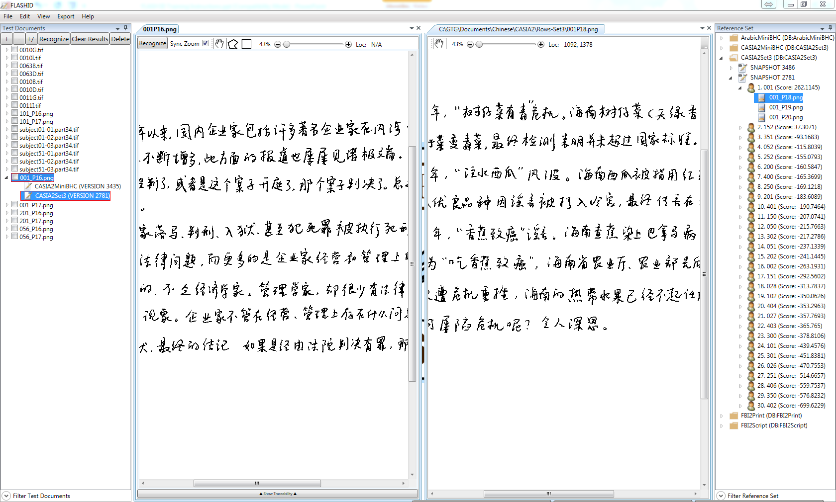
Reviewing Recognition Results (cont’d)
The scores represent an aggregation of similarity scores for each grapheme in the test document
Test Documents are compared to Writers
Scores can be viewed as an aggregate scores or average scores
Reference Documents can be viewed side-by-side with Test Documents to enable comparisons
The User can scroll through Reference Documents using the arrow keys
Zooming of the two views can be synchronized

Slide 26
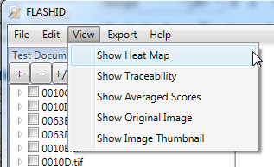
Detailed Recognition Results Review
FLASH ID has several features that facilitate a more detailed review of the Recognition Results
Show Heat Map
Show Traceability
Show Average Scores
Show Original Document
Show Image Thumbnail
Enabled via the View Menu Item on the Main Menu

Slide 27
Heat Map
The Heat Map is a visual representation of the relative strength of the scoring of each grapheme in the Test Document for a specific writer
Only displays on Test Documents
The warmer the color, the stronger the match
Must have a Test Document open, a Reference Writer selected, and the Show Heat Map option enabled
Useful for helping to identify interesting areas of the Test Document to review

Slide 28
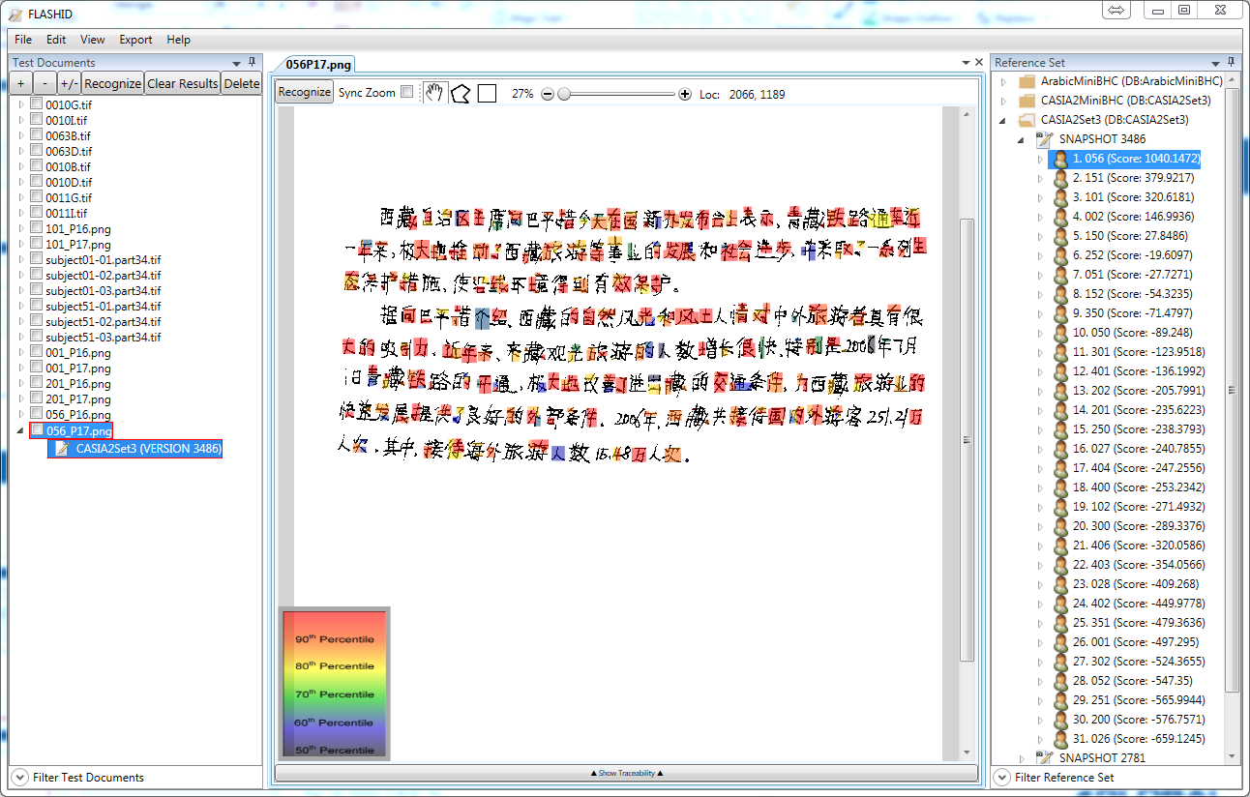
Sample Heatmap

Slide 29
Traceability
The Traceability Matrix is a grid display of the graphemes in the Test Document and the scores for each grapheme for each of the top 20 Writers
Only displays with Test Documents
Must have a Test Document open, a Reference Set Snapshot selected, and the Show Traceability option enabled
Traceability Matrix columns are sortable
Clicking on an individual grapheme in the matrix zooms the display and highlights the selected grapheme
Right clicking on the Traceability Matrix and selecting the Select All menu option highlights all graphemes
Useful for analyzing the scoring results

Slide 30
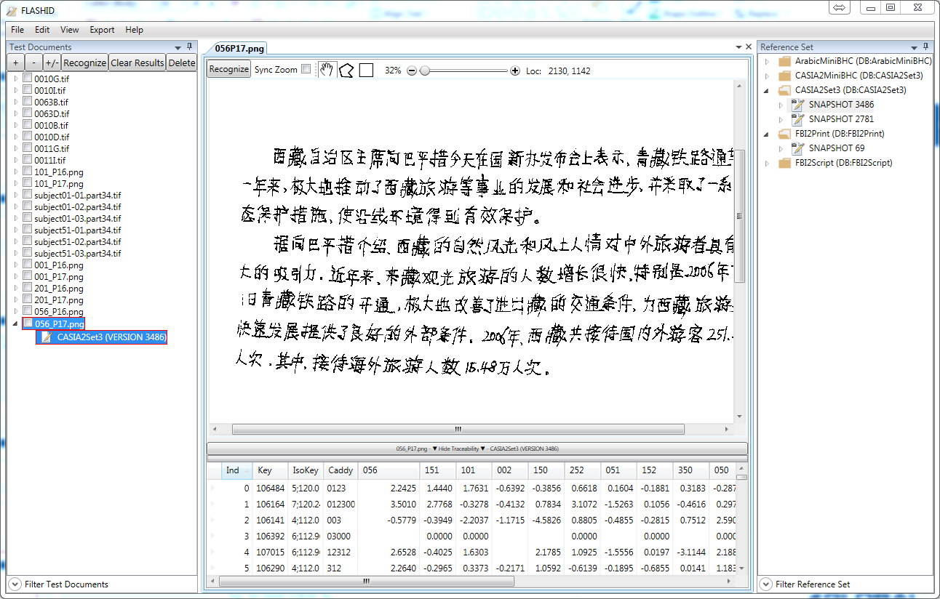
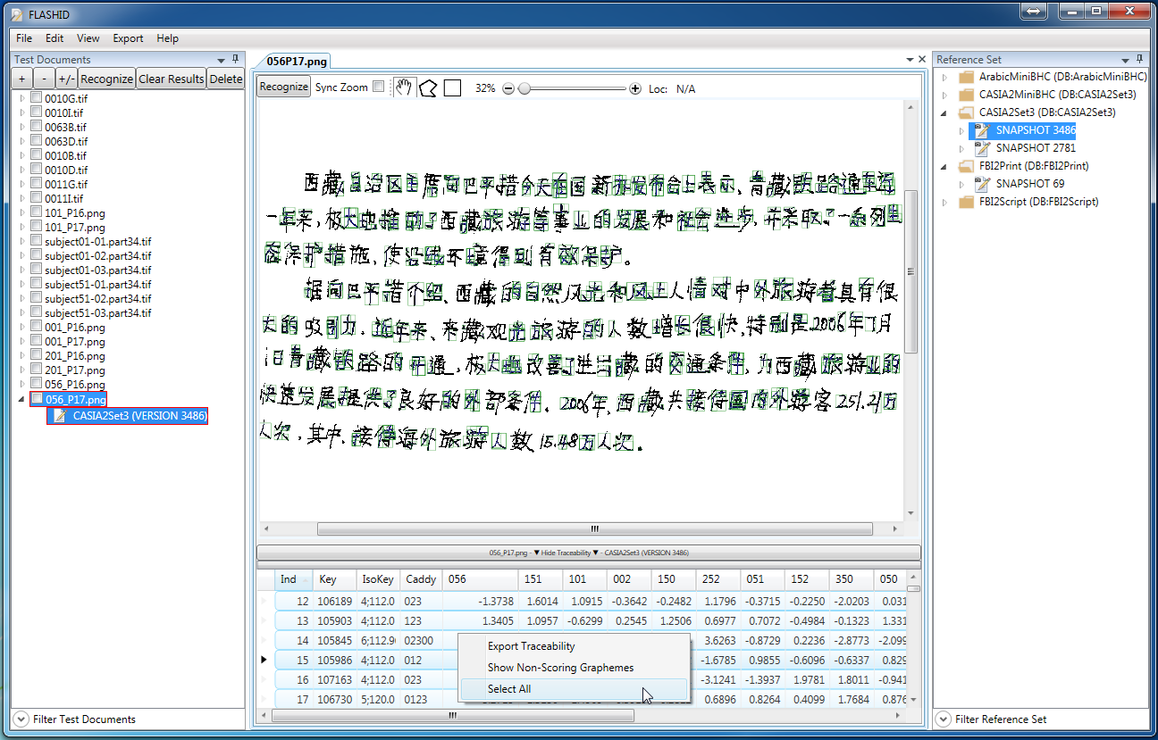
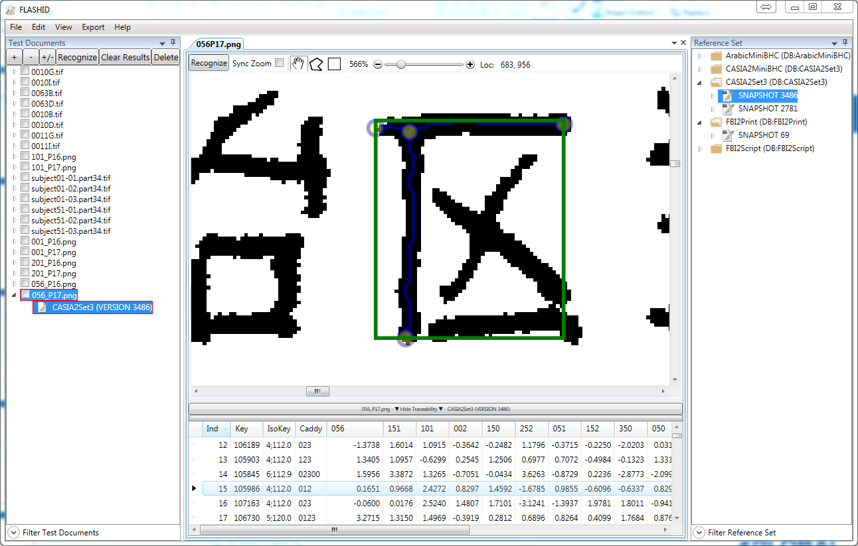
Sample Traceability Views

Slide 31
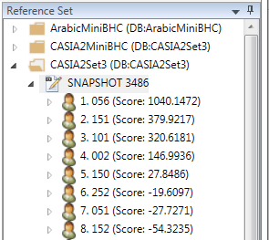
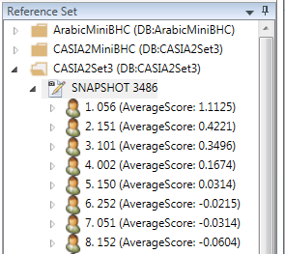
Show Average Scores
By default, the scores displayed in the Recognition Results Snapshot list are the aggregation of the scores for each Test Document grapheme
Selecting the Show Average Scores menu item toggles between showing aggregate scores and average scores
This can help identify Writers with strong matching graphemes but with limited quantity

Slide 32
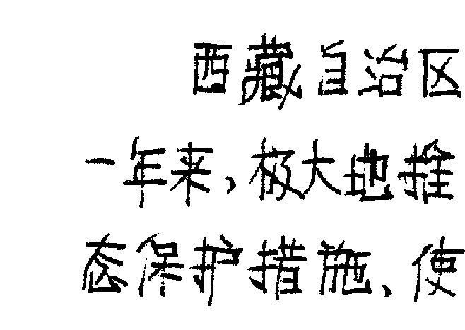
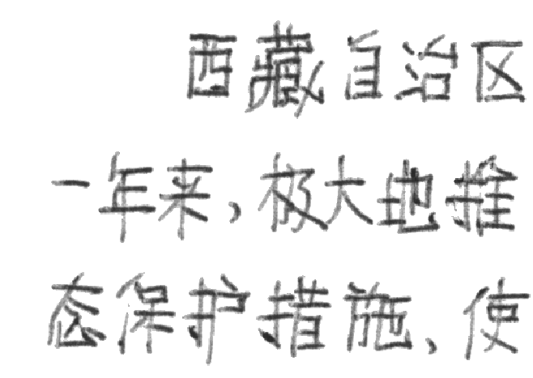
Show Original Document
Each Test Document is converted to a bi-tonal image when it is loaded
The bi-tonal image is stored along with the original image
The default view of a Test Document is the bi-tonal image
The user can toggle between the bi-tonal version and the original version of the image by selecting the Show Original Document menu item

Slide 33
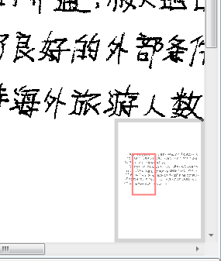
Show Image Thumbnail
Selecting the Show Image Thumbnail menu item displays a image thumbnail at the bottom right corner of the Test Document and Reference Document
The thumbnail shows the whole image along with the current view port
Clicking and drag the view port indicator can be used to scroll around the document

Slide 34
Managing Test Documents
Test Documents and their Recognition Result Sets are stored in a SQL Server database
Test Documents and Recognition Result Sets can be deleted individually using context sensitive menus
Test Documents can be renamed using the context sensitive menu
FLASH ID provides a line removal function to eliminate horizontal lines on Test Documents
After running line removal the updated image is stored in place of the original bi-tonal image

Slide 35
Metadata
FLASH ID provides the ability to associate metadata with Test Documents, Reference Set Writers, and Reference Set Documents
Metadata is stored in the database and can be exported and used to filter the Test Document list and Reference Set list

Slide 36
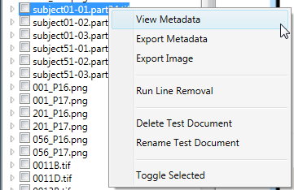
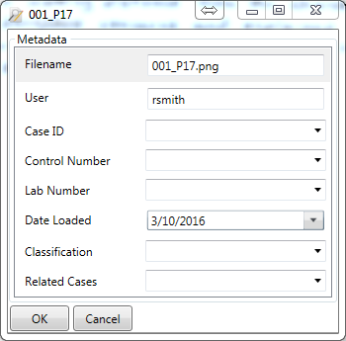
Test Document Metadata
Test Document metadata can be added during the Test Document load process if they are added one at a time
Metadata can be added after loading by right-clicking on a Test Document name and selecting View Metadata from the popup menu
Note, Test Document metadata fields are set via system configuration and cannot be added during operation

Slide 37
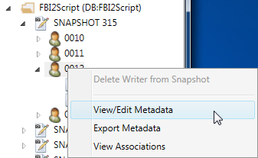
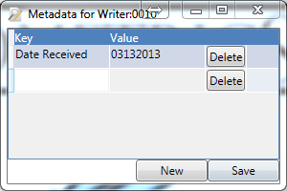
Reference Set Metadata
Metadata can be associated with Reference Set Writers and Reference Set Documents
Reference Set Metadata are Key-Value pairs
The set of Keys are dynamic and can be expanded as needed during operation
Metadata can be edited by right-clicking on a Reference Set Writer or Reference Set Document and selecting View/Edit Metadata
New Key/Value pairs can be added, deleted, or modified from this view
Click the New button to add a new entry
Edit the entries “in place” in the table
Click the Delete button to delete entries
Click the Save button to save changes

Slide 38
Exporting Data
FLASH ID provides the ability to export the following information:
Test Document image
Test Document metadata
Recognition results
Traceability matrix data
Reference Set Snapshot Writer and Document list
Reference Set Snapshot Writer and Document metadata
Export features are accessed via context sensitive menus on the Test Document list, Reference Sets tree view, and the Traceability Matrix grid

Slide 39
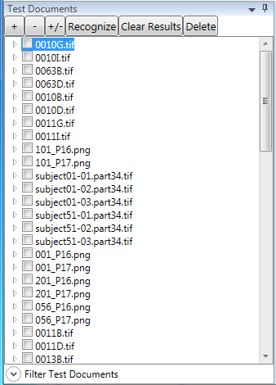
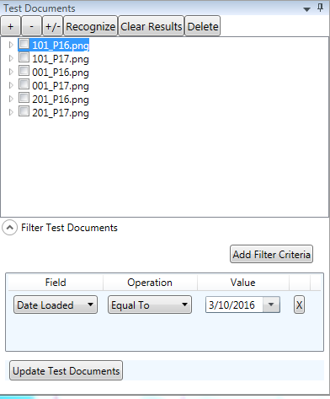
Test Document Filtering
The list of Test Documents can be filtered using previously entered metadata
Expand the Filter control by clicking the Filter Test Documents item at the bottom of the Test Documents window
In the control that appears, click the Add Filter Criteria button to add filter criteria, then click the Update Test Documents button to filter the list
To clear the filter click the X button nest to a filter, then click the Update Test Documents button
Multiple entries in the filter list are combined using an AND operation

Slide 40
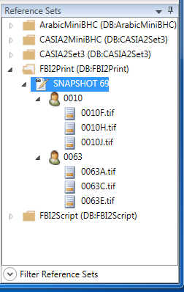
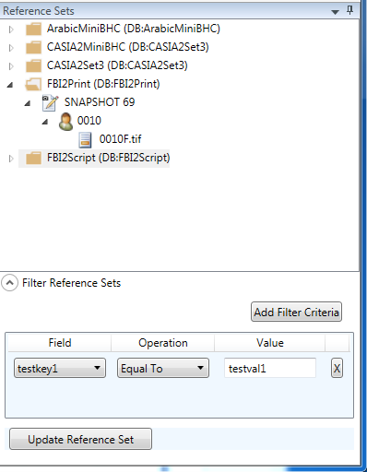
Reference Set Filtering
The list of Reference Set Writers and Documents can be filtered using previously entered metadata
Expand the Filter control by clicking the Filter Reference Sets item at the bottom of the Reference Sets window
In the control that appears, click the Add Filter Criteria button to add filter criteria, then click the Update Reference Set button to filter the list
To clear the filter click the X button next to a filter item, then click the Update Reference Set button
Multiple entries in the filter list are combined using an AND operation

Slide 41
Bulk Operations
FLASH ID support bulk operation of the following functions:
Running recognitions
Deleting Test Documents
Clearing Recognition Results Sets
Exporting Recognition Results
Exporting Traceability Matrix data
Bulk operations are performed by selecting multiple Test Documents using the checkbox next to each document
Action buttons for bulk operations include Recognize, Clear Results, and Delete [Test Document]
Exporting of recognition results and traceability matrix data can be exported in bulk by selecting multiple Test Documents and selecting the appropriate menu items on the Export main menu item

